Slide 1
Heroes of CSS
Day 3
June 25th, 2016

Slide 2
Admin Work

Slide 3
Homework Assignment
Also, at this point everyone should have access to the class repository in GitHub. https://github.com/UCF-Coding-Boot-Camp/06-16-VW-Class-Content
Homework Assignment #1 is Due:
MW Class – Wednesday, June 29th, 2016
TTH Class – Thursday, June 30th, 2016

Slide 4
Homework Assignment
Really, work hard on this assignment! This assignment introduces you to fundamental concepts that we’ll be building the entire course-long.
Review In Class Material especially Exercises: https://github.com/UCF-Coding-Boot-Camp/06-16-VW-Class-Content Subdirectories ending with --class-content
Work with your peers! It’s much better than screaming at your computer alone.
Ask Questions on Slack! Your peers, TAs, and Instructors are all here to help when they can.

Slide 5
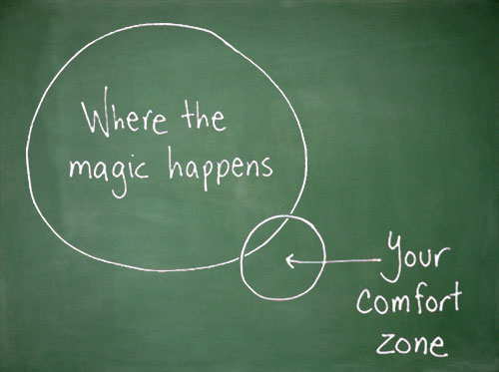
Most Important of All….
Just Submit SOMETHING… Even if it seems pretty crummy!

Slide 6
Warning!

Slide 7

Brace Yourselves
Today is going to be a bit tough.
But trust us!
It will all look easy a few weeks from now.

Slide 8
Brace Yourselves
Don’t expect to understand EVERYTHING at once.
Today is all about getting immersed

Slide 9
CSS Recap
Tell your neighbor all about it…

Slide 10
Critical Question
What is “CSS”?

Slide 11


HTML / CSS Definitions (*yawn* unimportant)
HTML: Hypertext Markup Language – (Content)
CSS: Cascading Style Sheets – (Appearance)
HTML/CSS are the “languages of the web”. Together they define both the content and the aesthetics of a webpage – handling everything from the layouts, colors, fonts, and content placement. (Javascript is the third – handling logic, animation, etc.)

Slide 12


HTML / CSS Analogy
HTML Alone
Like writing papers in “Notepad”.
Can only write unformatted text.
HTML / CSS
Like writing papers in Microsoft Word.
Can format text, page settings, alignment, etc. based on “highlighting” and menu options.

Slide 13

Basic HTML Page - Result

Slide 14

Enter CSS - Result

Slide 15
Critical Question
How do we style HTML…
Elements?
Classes?
IDs?

Slide 16

CSS Syntax
CSS works by hooking onto selectors added into HTML using “classes and identifiers”.
Classes use .classname, IDs #Idname, and elements their name
Once hooked, we apply styles to those HTML elements using css .

Slide 17
Lingering Questions
Questions so far?

Slide 18
Relative File Paths

Slide 19
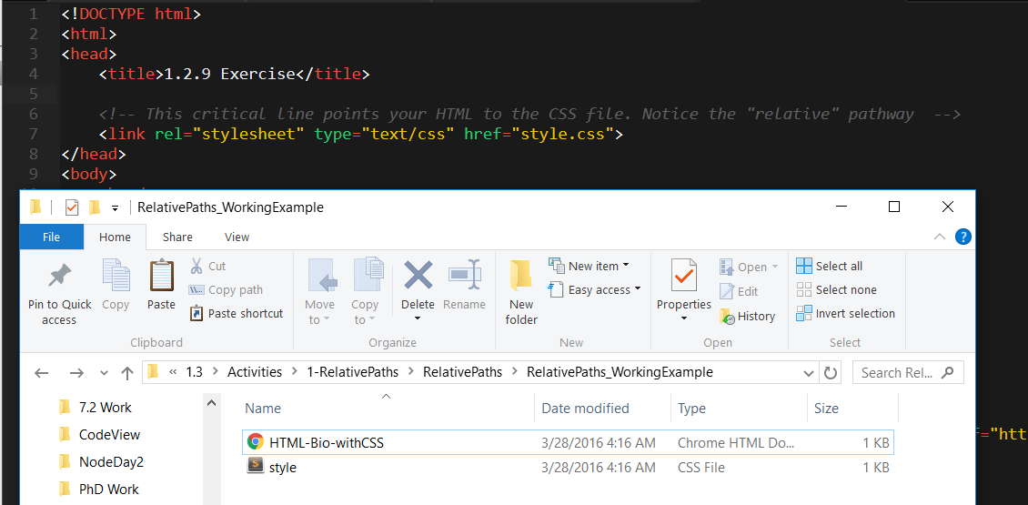
Relative File Paths
Relative file paths allow us to access other files (like CSS or image files) relative to the file we are looking at.

Slide 20
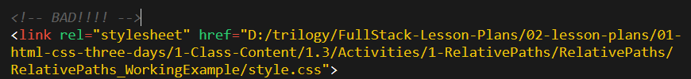

Absolutely No Absolute Paths
VERY VERY BAD
ALWAYS USE RELATIVE FILE PATHS.
Otherwise, when moving your web page or deploying your site – all of your links will fail to load correctly.
Remember there is no such thing as a “C:” drive on the internet.

Slide 21
Quick Demo
Instructor: Demo
(RelativePaths_DEMO | 1-RelativePaths)

Slide 22
> YOUR TURN!!
Activity: 1-RelativePaths| Suggested Time: 10 min
Assignment
Unzip the folder sent to you via slack.
Then edit the HTML files inside of each “RelativePaths” folder such that each HTML file can access the CSS file using relative paths.
An example is given to you in the “RelativePaths_WorkingExample” folder.

Slide 23
Box Model

Slide 24
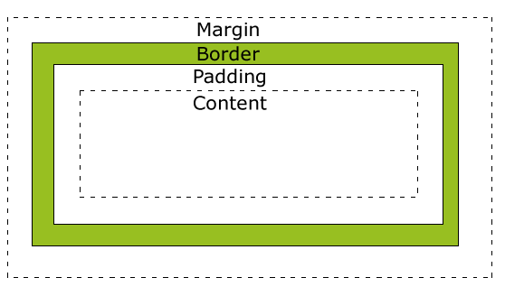
Boxes Upon Boxes
In CSS, every element can be considered to fit within a series of boxes. Each box can be individually adjusted to provide spacing between elements or to fill in elements with colors.
Styles can applied as follows: 20px 10px 10px 20px (top, right, bottom, left)

Slide 25
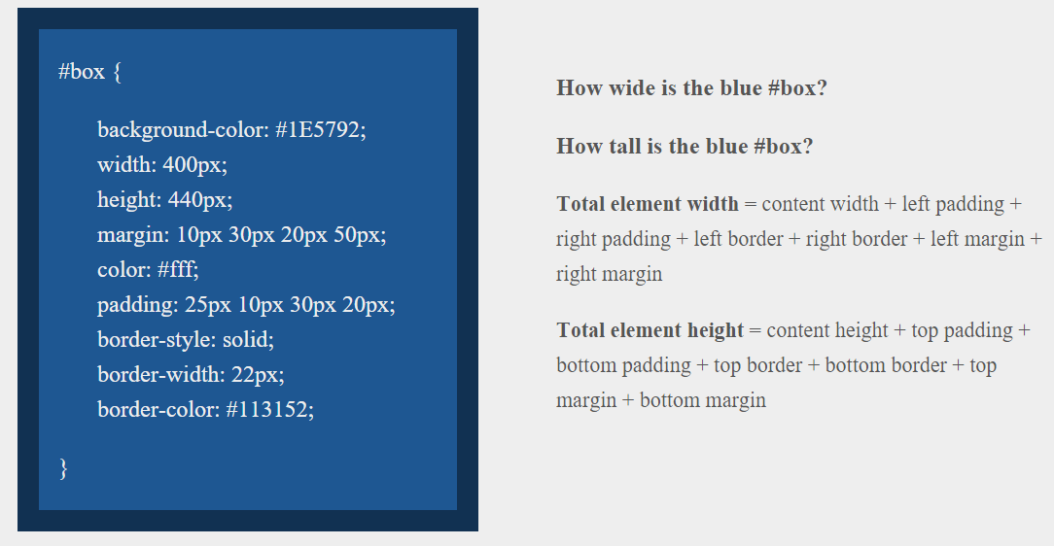
> YOUR TURN!!
Suggested Time: 10 min

Slide 26
> YOUR TURN!!
Answer
Width: 474 px (no margin), 554 px (with margin)
Height: 539 px (no margin), 569 px (with margin)

Slide 27
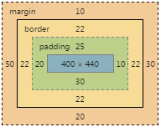
> YOUR TURN!!
Answer
Width: 474 px (no margin), 554 px (with margin)
Height: 539 px (no margin), 569 px (with margin)

Slide 28
We Be Floatin’

Slide 29

Take a Facebook Break…
Warning!
These next topics are fairly “tricky”… but VERY IMPORTANT.
Time to channel that inner genius.

Slide 30

The Concept of “Flow”
In HTML/CSS, (by default) every element displayed is governed by a concept called “flow”.
This means that HTML elements force their adjacent elements to flow around them.

Slide 31
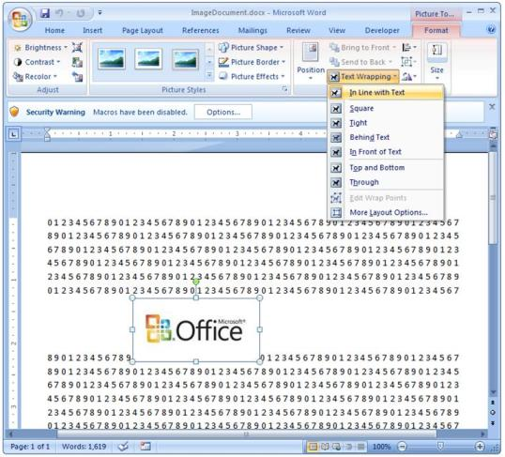
Flow Analogy to MS Word
This concept of “flow” is very similar to the wrap-text options you may be familiar with in Microsoft Word.
Just as in MS Word, you can have images in-line with text, on-top of text, etc.

Slide 32
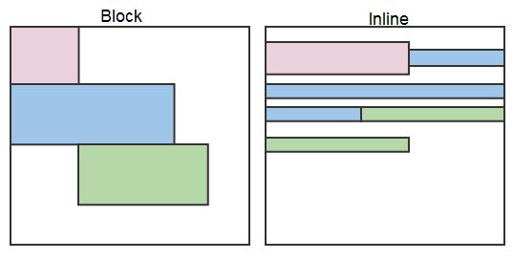
Block Elements
By default, many HTML elements (paragraphs, headers, div, etc..) are treated as block elements.
This means, they take up an entire line of space, unless you intervene with CSS properties.

Slide 33
Block Elements vs. Inline Elements
Now… contrast the block elements with inline elements.
By using float CSS properties, we can command our website to display multiple CSS elements adjacently.

Slide 34
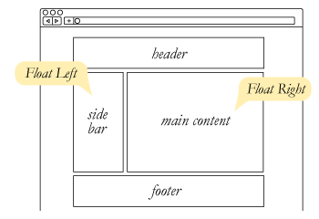
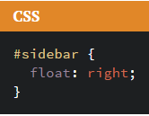
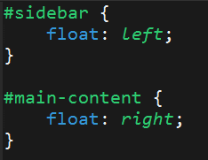
Floating
In order to convert these block elements into inline elements, we utilize a CSS property called float.
Floats are necessary for building web layouts

Slide 35
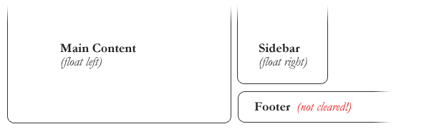
Clearing the Float
Sometimes… floats get in the way, and elements that we don’t want to be “in-line” are treated as such.

Slide 36
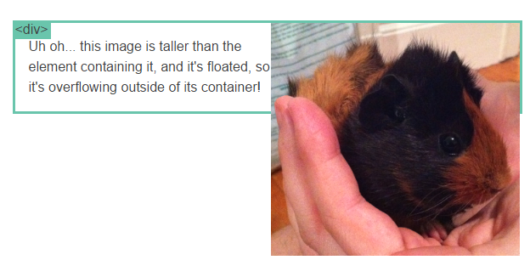
Clearfix Hack
Sometimes when elements don’t match up in size, we get situations like the above…

Slide 37
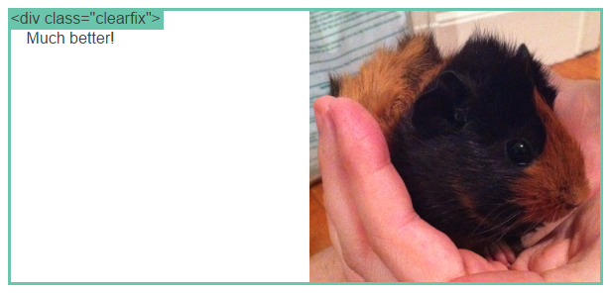
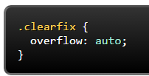
Clearfix Hack
We can get around it by using what’s called the “clearfix hack”. By using the CSS property overflow: auto, the first element will fill up the empty parts of the flow.

Slide 38

Quick Demo!

Slide 39
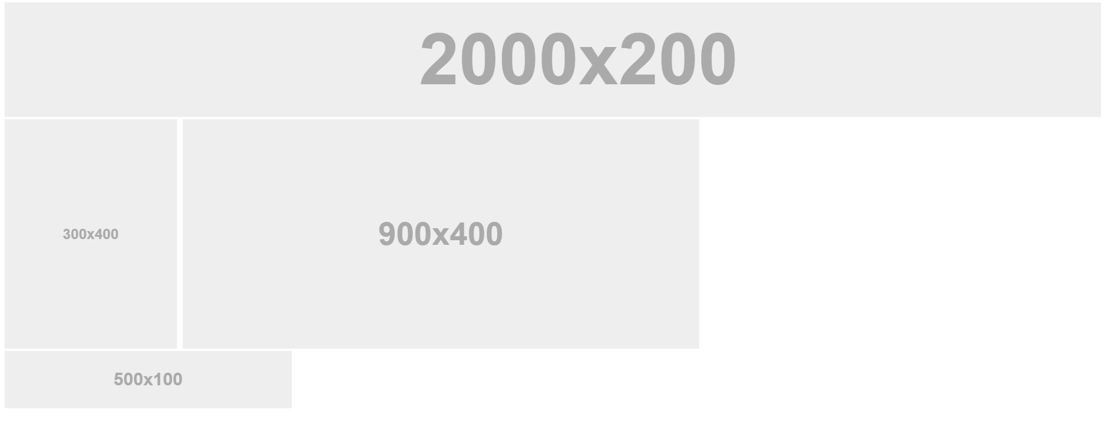
Quick Demo!

Slide 40
Quick Demo
Instructor: Demo
(2-FloatExamples)

Slide 41
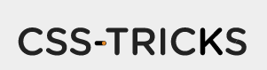
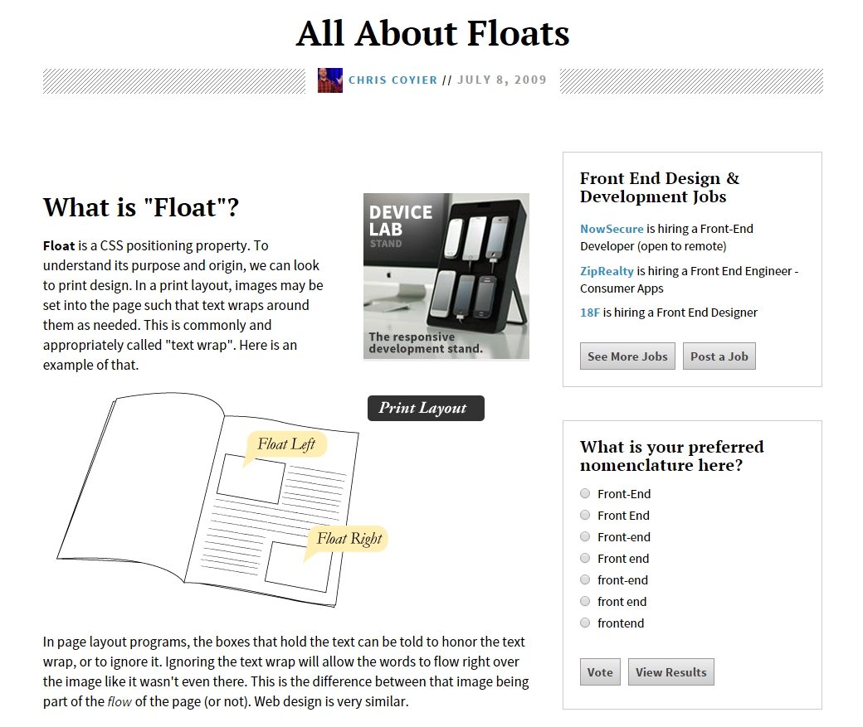
Fantastic Guide on Floats ****
To all serious front-end developers (this is a necessary read): https://css-tricks.com/all-about-floats/

Slide 42
> YOUR TURN!!
Activity: 3-FloatLayout-Activity | Suggested Time: 30 min
Assignment
In this activity, you will be flexing your newfound floating skills to create a conceptual layout. Eyeball the design to your best ability.
Additional instructions, sent via Slack.

Slide 43
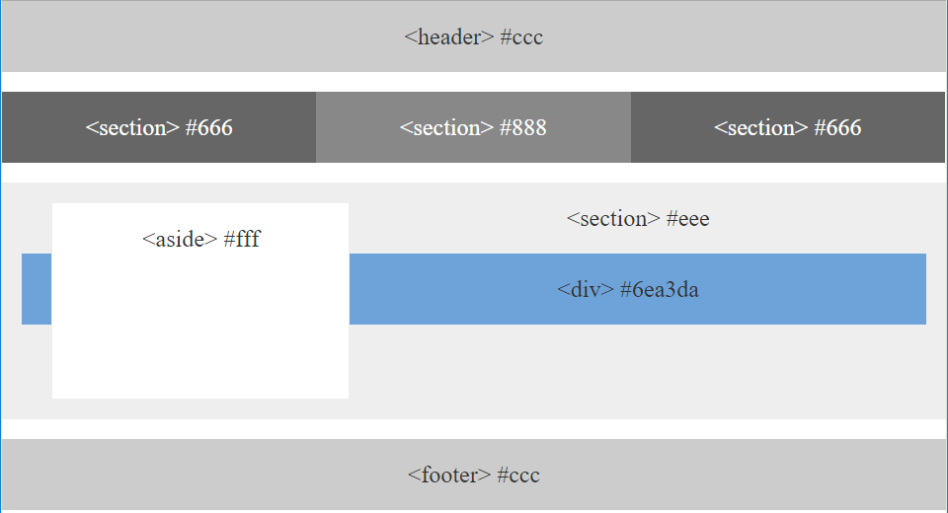
> YOUR TURN!!

Slide 44

Good work!
Your Brain may rest now

Slide 45
BREAK!

Slide 46
CSS Positioning

Slide 47
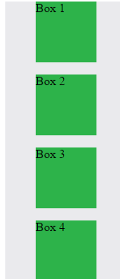
Position: Static (Default)
Four boxes placed statically (default)

Slide 48
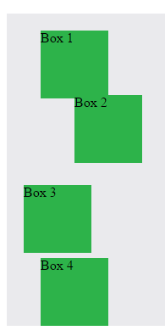

Position: Relative
Switching the boxes to relative nudges the boxes in relation to their “original” location.

Slide 49
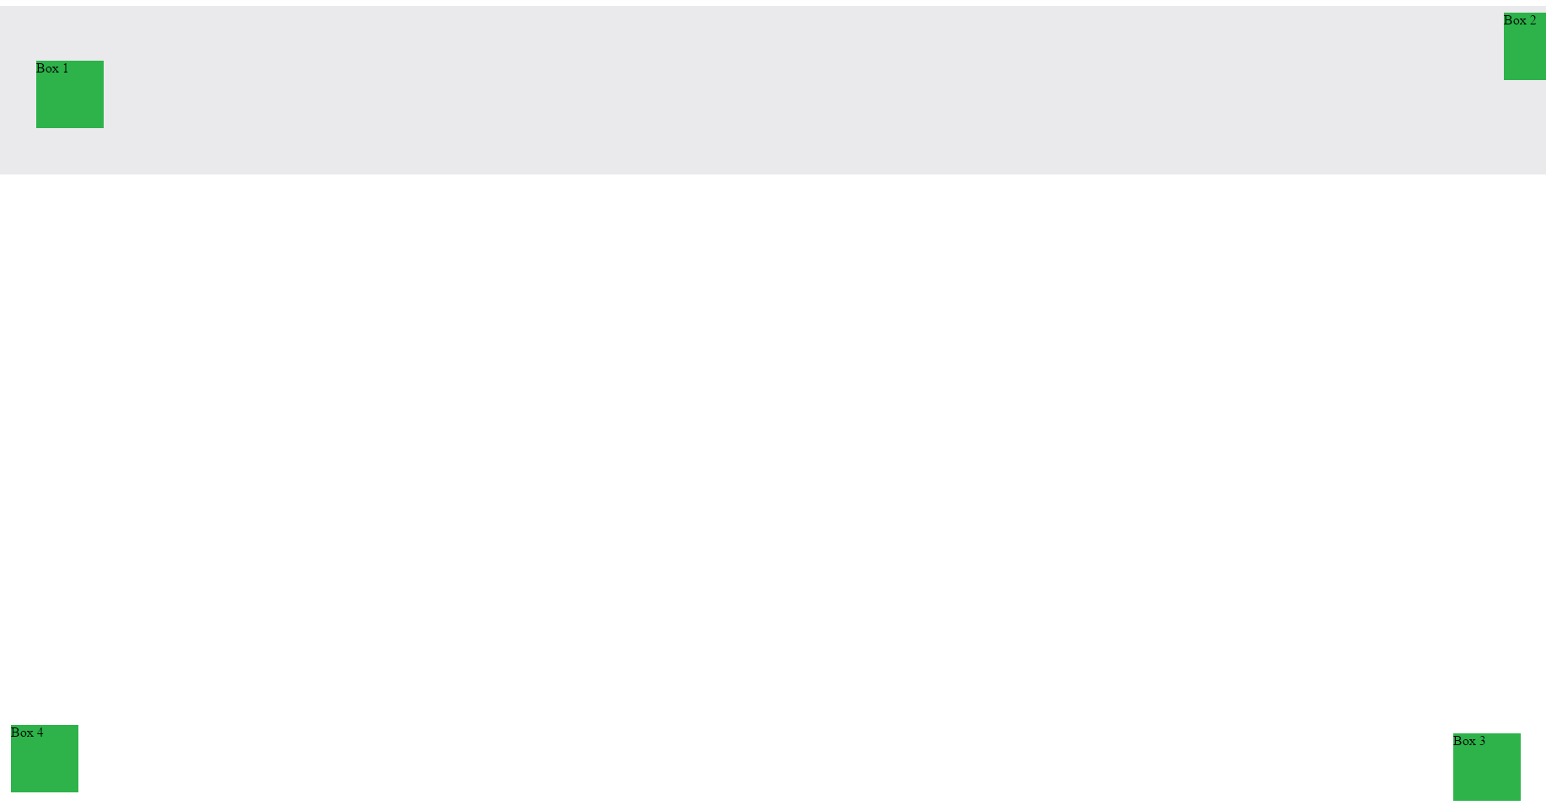
Position: Absolute
Position with location relevant to first “placed” element

Slide 50

Position: Fixed
Position with exact coordinates to the browser window

Slide 51
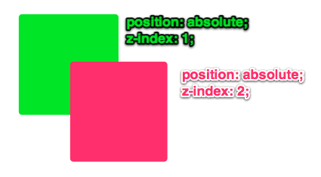
Layering with Z-Index
Z-Index allows you to layer elements on top of each other when placed in absolute coordinates

Slide 52
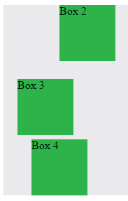
Hiding Things
Display none allows elements to be completely hidden from view.
This becomes useful because in later sections, we will be selectively activating and de-activating.

Slide 53
Quick Demo
Instructor: Demo
(5-CSS_PositionedLayout)

Slide 54
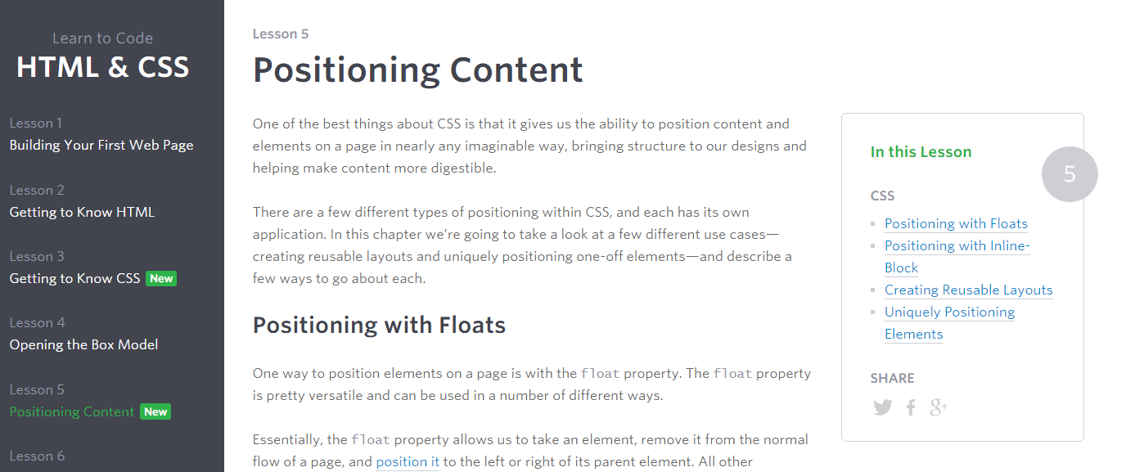
Great Resource
Another great read for front-end developers (and game designers): http://learn.shayhowe.com/html-css/positioning-content/

Slide 55
> YOUR TURN!!
6-CSS_Positioned_Activity | Suggested Time: 30 min
Assignment
In this activity, you will be flexing your newfound positioning skills to create another conceptual layout. Eyeball the design to your best ability.
Additional instructions, sent via Slack.

Slide 56

> YOUR TURN!!

Slide 57
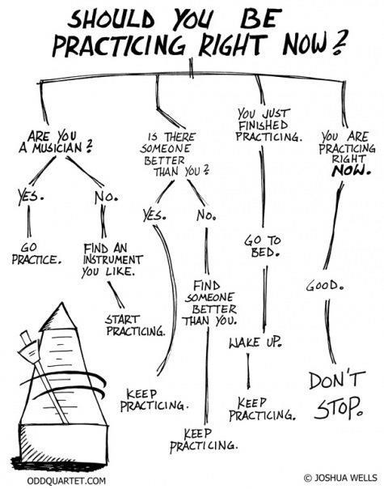
Advice
Re-do this at home. It’s a good one to firm up your HTML/CSS skills.
REMEMBER:
The best way to get good is to PRACTICE

Slide 58
Chrome Inspector

Slide 59
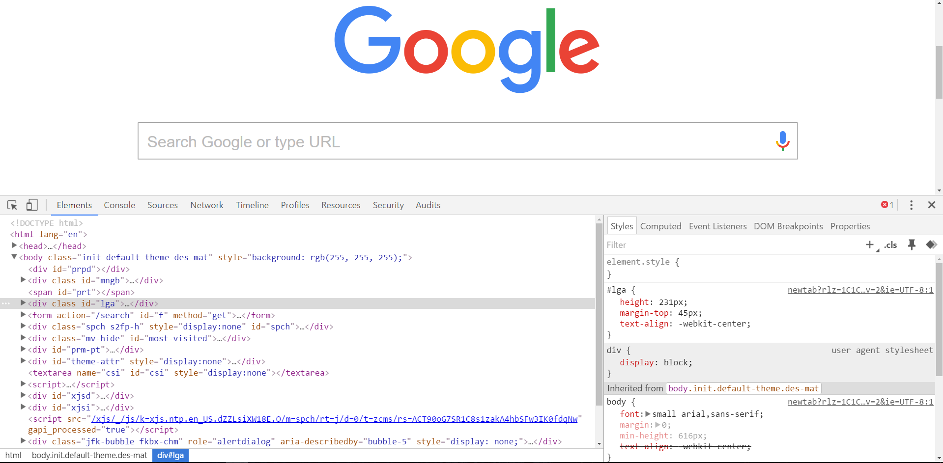
Chrome Inspector is Your Friend
To access chrome inspector: Right click on a page then hit “Inspect”
It will allow you to inspect the HTML, CSS, and more!

Slide 60

Chrome Inspector is Your Friend
Using Chrome Inspector you can readily edit any webpage (your own or otherwise) to see the immediate impact of HTML or CSS changes

Slide 61
Next Class!
We’ll be coming back to this next class ☺

Slide 62
Recap + Reassurances

Slide 63


Slide 64
Questions?

Slide 65
EXTRA MATERIAL

Slide 66
> YOUR TURN!!
Assignment
For the next 15 minutes, take a website that you commonly use (Amazon, Google, Huff Po, etc.) and heavily modify it using the Google Developer Tools.
Be sure to at least modify:
Content (Change words)
Colors
Spacing
Etc.
Send a screenshot to the class’ slack profile when you’re done.

Slide 67
CSS Resets

Slide 68

Loading Multiple CSS Files ***(Very Important!!!)***
One of the most powerful aspects of CSS is the ability to deploy multiple CSS files simultaneously.
This allows developers the ability to create complex designs – made up of multiple design elements.
Just remember the loading order matters!!!

Slide 69
What Browser?
By a show of hands…
Which browser do you use?

Slide 70

Battle of the Browsers
Under-the hood there are often significant differences between how browsers render webpages.
These differences in rendering agents can mean HTML/CSS gets displayed differently in each.
As designers/developers, creating cross-browser compatible websites is critical.

Slide 71

Reset.css (or Normalize.css)
Reset.css ensures that all browser-specific css has been reset, so it appears the same in all browsers.
This means you will have to re-style everything yourself

Slide 72
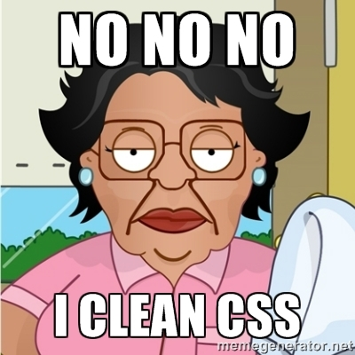
Why CSS Resets Matter
It’s important for creating browser-compatible websites
It’s an example of using someone else’s CSS in your website!!!
It’s a common Front-End Developer Interview question.

Slide 73
> YOUR TURN!!
Assignment
Follow the instructions given via slack to incorporate a reset.css file into a basic HTML file.
Note the impact the reset file makes after its inclusion.

